Slide 1

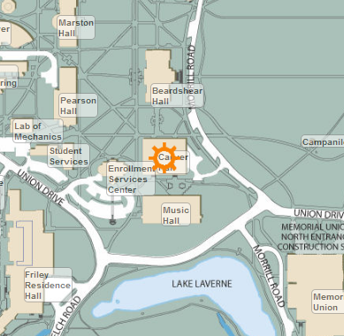
CyCearch
Group 4: Ryan Haack, Garrett Phelps, Trevor Lund,
Kaitlin McAbee, Alex Maxwell

Slide 2
Target – Iowa State students
Problem Statement
-Iowa State has both a large campus and a large website
and engineering student’s time is precious
Android App
ISU website
Find a class
Find a professor
Computer and Software Engineering

Slide 3
Usability Features
Locate a class
Obtain information on a class
Locate a professor
Call a professor
Email a professor

Slide 4
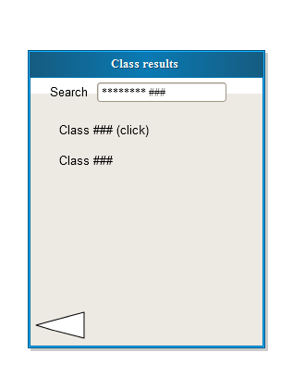
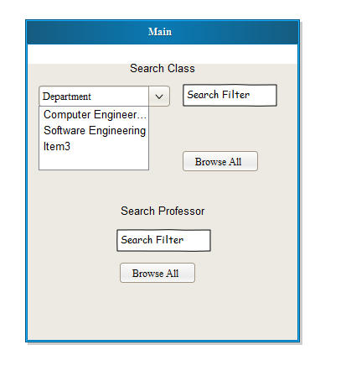
Interaction with users

Slide 5
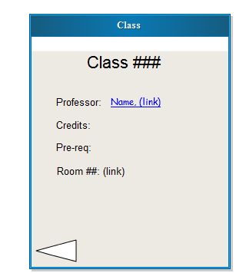
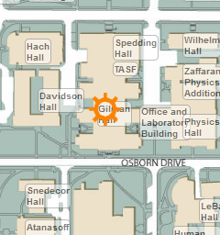
Interaction with users

Slide 6
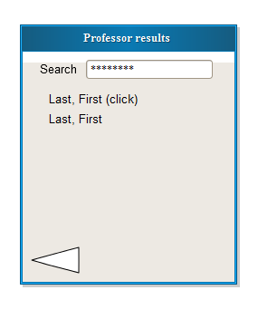
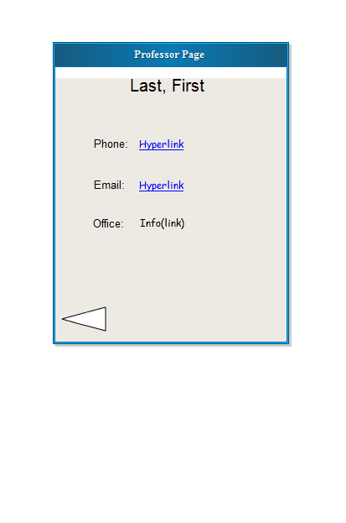
Interaction with users

Slide 7
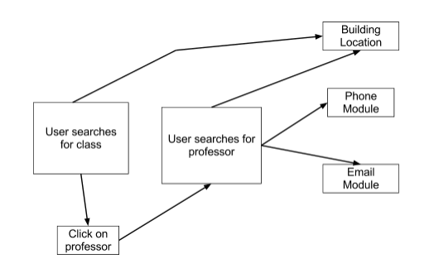
Architectural View

Slide 8
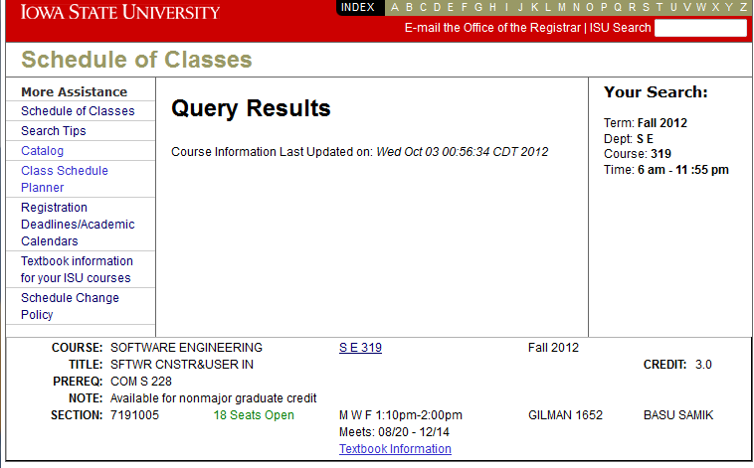
Parsing Class Info

Slide 9
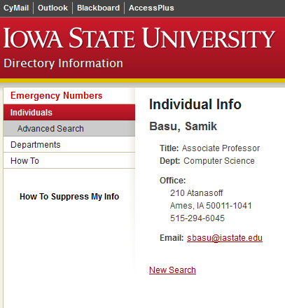
Parsing Professor Info

Slide 10
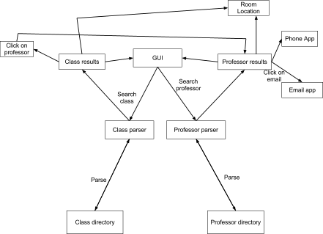
Architectural View

Slide 11
Languages/Frameworks
Java
Android Development Kit
Mobile Device Emulator

Slide 12

Responsibilities
Garrett/Ryan-
UI title screen
UI professor screens
parse professors
link to phone #, email
Kaitlin/Alex/Trevor-
UI class screens
parse classes
link to iastate map

Slide 13
Timeline
Oct. 12:
Working shell completed
Oct. 26:
Class parser completed
Nov. 9:
Implement all structures completed
Oct. 19:
Professor parser completed
Nov. 2:
Map locator completed
Nov. 16:
Testing completed

